Slide 1

Our Project: Buzz or Bust
Questionnaire: Data gathering
Case Studies : Neural Network and Randon Forest
Findings and Limitations: how might be used
Repo: https://github.com/jvbonini/WhyExpat_site
Team Members: Lei Qin | Rob Seaberg | Winnie Wu | Joao Victor Bonini

Slide 2


Slide 3
70 Million

Slide 4
www.
.net

Slide 5
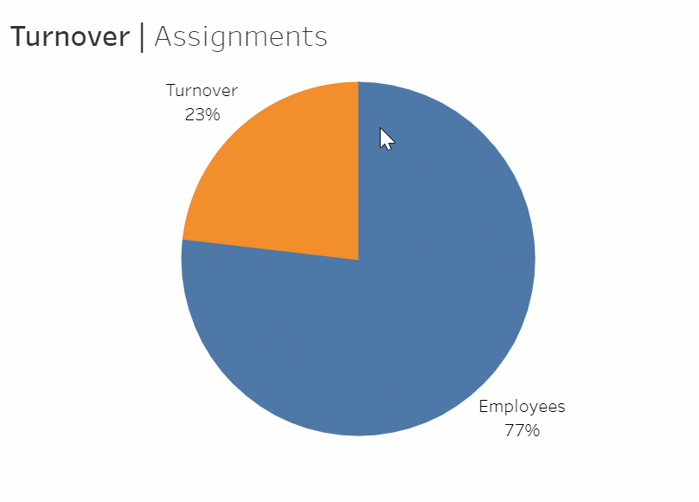

Our Project

Slide 6
Our Project
'satisfaction_level'
'last_evaluation'
'promotion_last_5years'
'average_montly_hours',
'Work_accident'
'number_project'
'salary'
'leader_host'
'culture_host'
'culture_home'
'buzz_bust'
'function_host'
'business Size_host'
'economic Perspective_host'

Slide 7

Questionnaire
Data gathering
Viewers perusing the site have an opportunity to fill out the questionnaire and add to the database
Data that is collected can be used to further hone the models and give stronger predictions

Slide 8
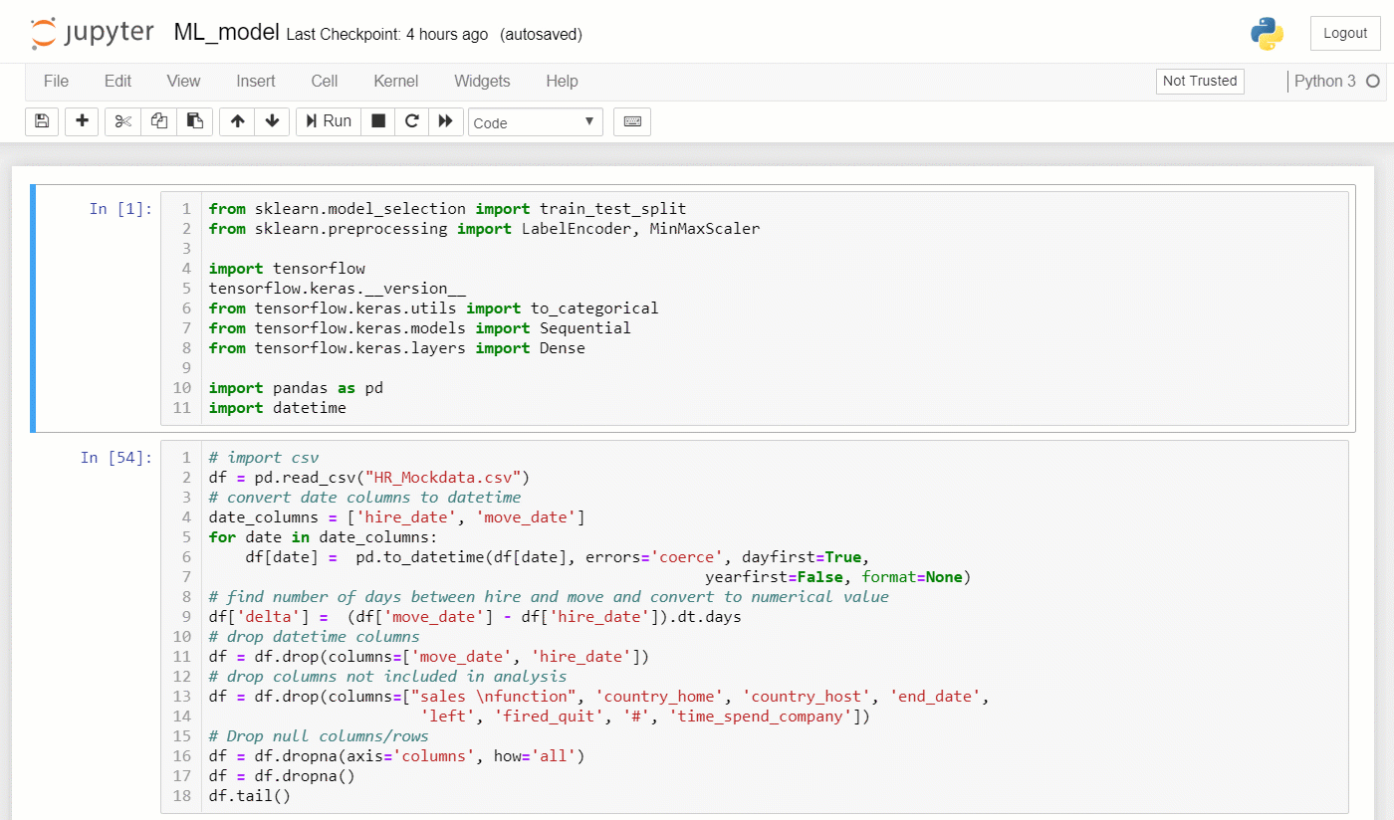
Case Studies
Neural Network
Notes:
45 seg

Slide 9
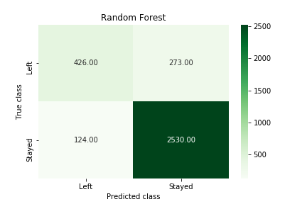
Case Studies
Random Forest
Random Forest (Binary classification)
Model accuracy: 0.853
Precision:
Retention rate:
79.1% (original)
90.0% (RF model)
Notes:
imbalanced classification
How likely people will stay if model predicts stay?
precision is "how useful the search results are", and recall is "how complete the results are".
precision (also called positive predictive value) is the fraction of relevant instances among the retrieved instances, while recall (also known as sensitivity) is the fraction of relevant instances that have been retrieved over the total amount of relevant instances.
Using test set
(94.3%-84.7%)/(1-84.7%)=62.7%
https://en.wikipedia.org/wiki/Precision_and_recall?source=post_page---------------------------
True positives are data point classified as positive by the model that actually are positive (meaning they are correct), and false negatives are data points the model identifies as negative that actually are positive (incorrect).

Slide 10
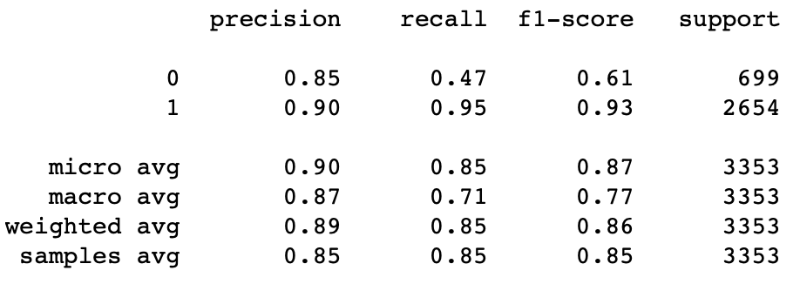

Slide 11
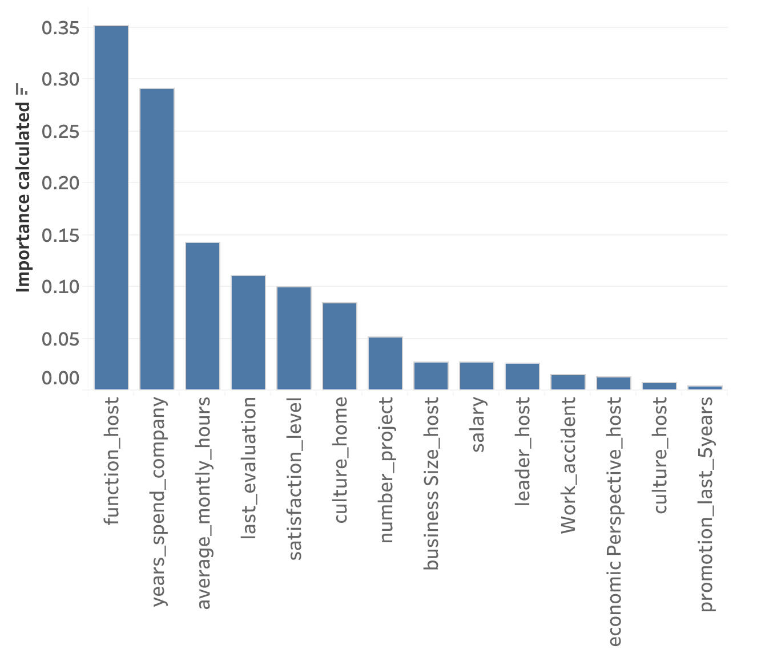
Case Studies
Random Forest
Random Forest
Feature importance

Slide 12
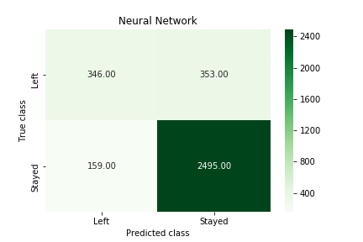
Case Studies
Random Forest
Neural Network
Model accuracy: 0.847 (loss: 0.333)
Precision:
Retention rate:
79.1% (original)
88.0% (NN model)

Slide 13
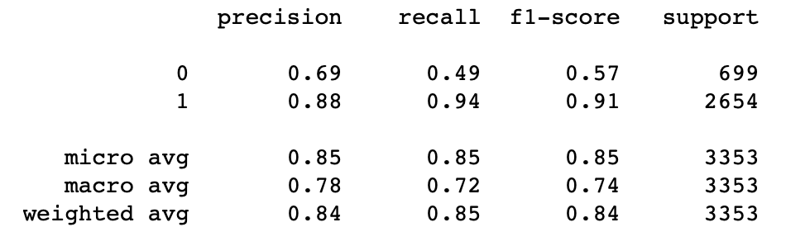

Slide 14
Findings and Limitations
How might be used
To be included

Slide 15
70 Million

Slide 16
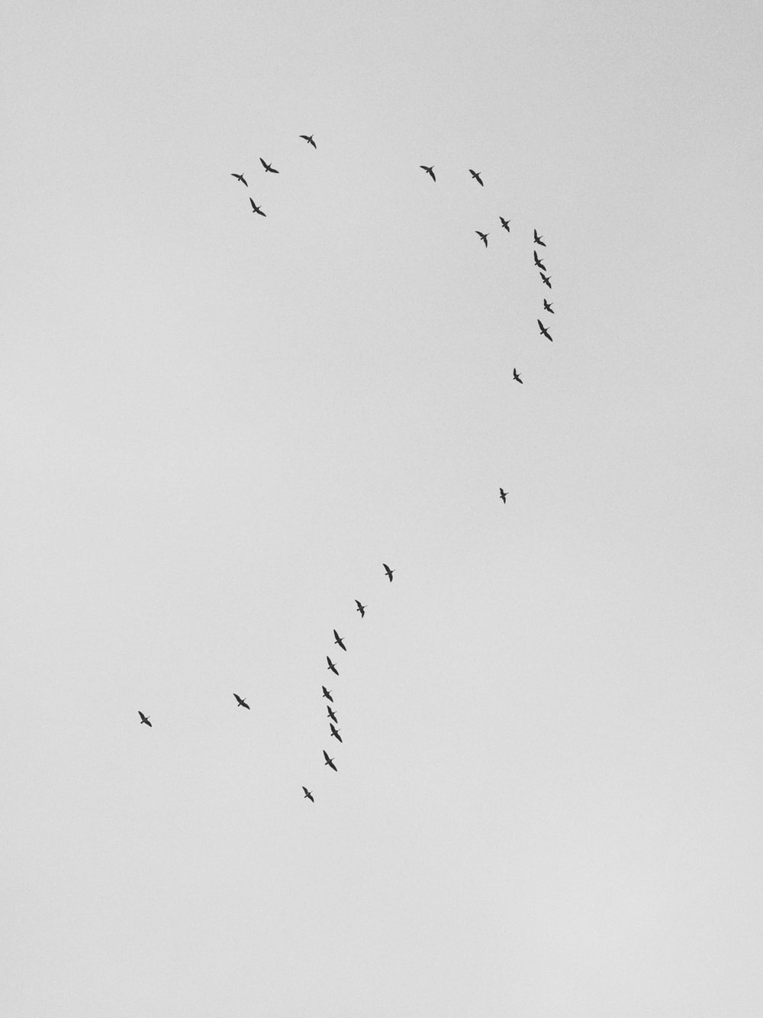
...Questions

Slide 17

| End |
Lei Qin | Rob Seaberg | Winnie Wu |Joao Victor Bonini
www.
.net

Slide 19
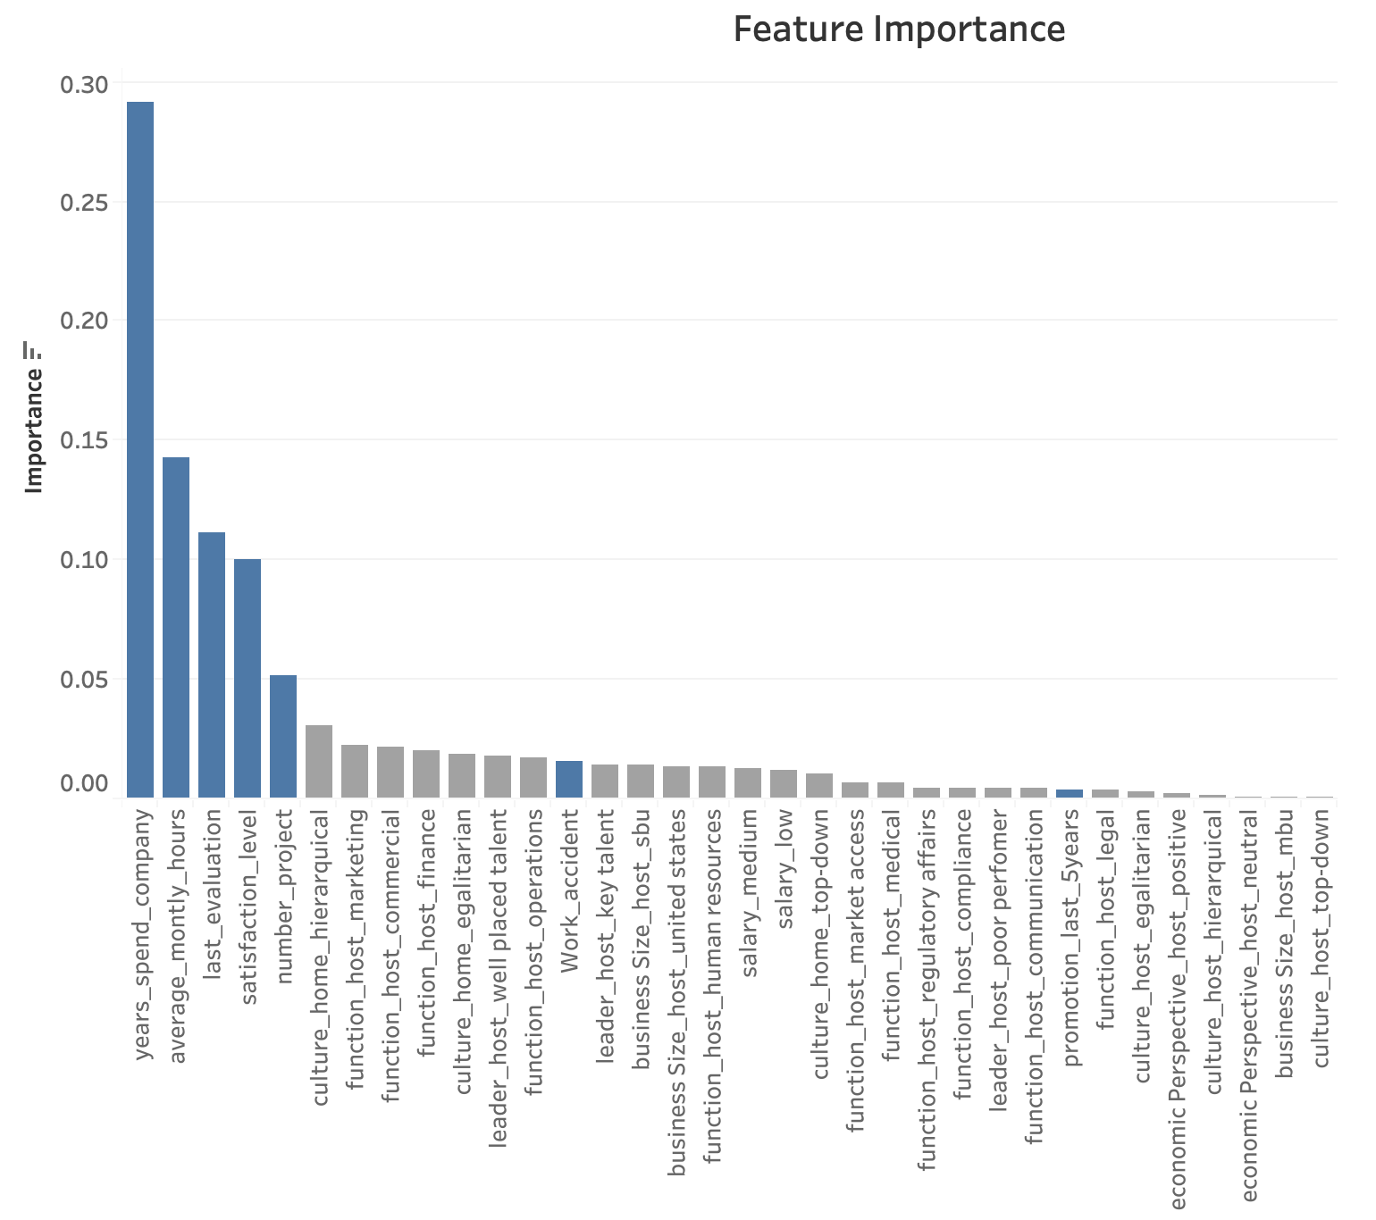
Notes:
Blue
Grey: catergorical data

Slide 20
Something we can work on
Model evaluation: Roc
Tree

